Slide 1
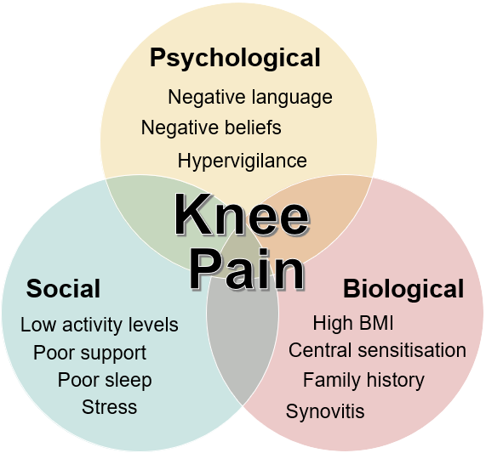
[CQE 2021]
South Tyneside CCG Small Group education – September 2021
Persistent Pain (Osteoarthritis)

Slide 2
Acknowledgements
Original material prepared by the Clinical Quality and Education team, Pegasus Health, Christchurch New Zealand.
Others consulted by Pegasus while preparing the original topic include:
Pegasus Small Group Leaders: Jennifer Lawrenson (GP), Joy Harding (PN), Stuart Walker (CP)
Dr Tracey Pons, Specialist Registered Pain Physiotherapist
Associate Professor Ben Darlow, Musculoskeletal Specialist Physiotherapist and Clinical Lecturer, University of Otago
Blair Cross, Occupational Therapist/Clinical Coordinator, Burwood Pain Management Centre
Dr Ian Holding, Musculoskeletal Pain Specialist, Burwood Pain Management Centre
Sally Watson, Canterbury Initiative
Julie Potter, Canterbury Initiative Project Manager
Nikki Elliot, Canterbury Initiative Clinical Analyst
Paul Bridgford, Team Leader Analysis, Pegasus Health
Ester Vallero, CALD Health Manager, Pegasus Health
Irihapeti Mahuika, Director of Hauora Māori and Equity, Pegasus Health
Melody Tuliau, Hauora Māori Manager, Pegasus Health
Adaptation and update for South Tyneside July 2021 supported by:
Dr Jon Tose, GP Northern Moor Medical Practice, GP Appraiser Greater Manchester, Clinical Editor Healthpathways NHS South Tyneside Clinical Commissioning Group

Slide 3
Learning Objectives
After completing the pre-reading and attending this Small Group meeting, participants will be able to:
Describe persistent pain and how it is influenced by multiple biopsychosocial factors
Assess elements that contribute to an individual’s pain using the biopsychosocial model of health and wellbeing and discuss how they can be addressed
Recognise how your interaction with a patient can positively or negatively affect a patient’s journey
Explain how imaging correlates poorly with level of pain or loss of function
Review the current evidence for medications and surgical interventions and understand their limitations
Identify inequity and outline ways to reduce barriers contributing to persistent knee pain
Outline a teamwork approach to supporting patients with persistent pain

Slide 4
Persistent pain
[Tasmanian Health Service 2014]

Slide 5
Personalised Care
What matters to me
Working in partnership with my clinician and wider care team
Choosing from the available options
Building knowledge skills & confidence
Connecting to help & support in my community
Designing my own plan, supported by professionals
Managing my own budget & support, with help if I choose
Shared decision making
Personal health budgets & integrated personal budgets
Enabling Choice
Personalised care & support planning
Health coaching & supported self-management
Social prescribing

Slide 6
4Ps Framework
Pain
Performance
Psychology
Past Medical History
[CQE 2021a]

Slide 7
Radiology report: right knee pain with crepitus
Findings:
There is severe osteoarthritis in the medial and patellofemoral compartments with joint space narrowing and osteophyte formation. Moderate osteoarthritis affects the lateral compartment, also medially in the left knee.

Slide 8
What management options are there?
Reassurance
Empowerment of patient involvement and self-management
Addressing overall health
Exercise and weight loss (best evidence)
Medication review
Using positive language and phrases
Referral

Slide 9
What referral options are available?
Biological options?
Psychological options?
Social options?
How do you support patient self referral to these services?

Slide 10
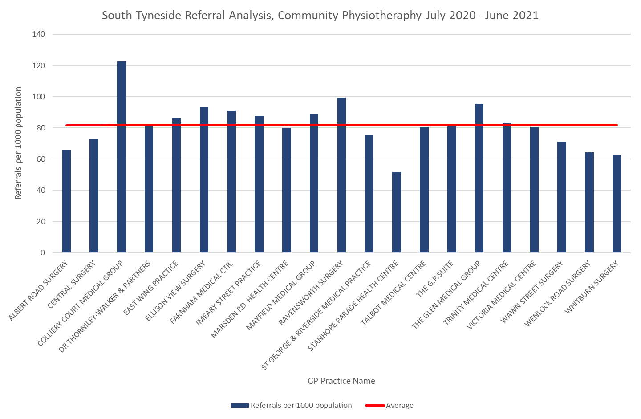
South Tyneside CCG – Community Physio Referrals

Slide 11
South Tyneside CCG – Orthopaedic Referrals

Slide 12
Prescribing for Leone
Exercise rehab and weight loss?
Topical capsaicin/NSAIDs?
Oral NSAIDs/paracetamol/codeine?
Stronger opioids?
Amitriptyline/SSRI/gabapentin?
Other?

Slide 13
Capsaicin 0.025% Prescribing South Tyneside CCG - Q4 20/21

Slide 14
NSAIDs Prescribing South Tyneside CCG – Q4 20/21

Slide 15
Jack
Physiotherapy
More
Meds
Address frustration
Refer pain clinic
Surgery
[CQE 2021b]

Slide 16
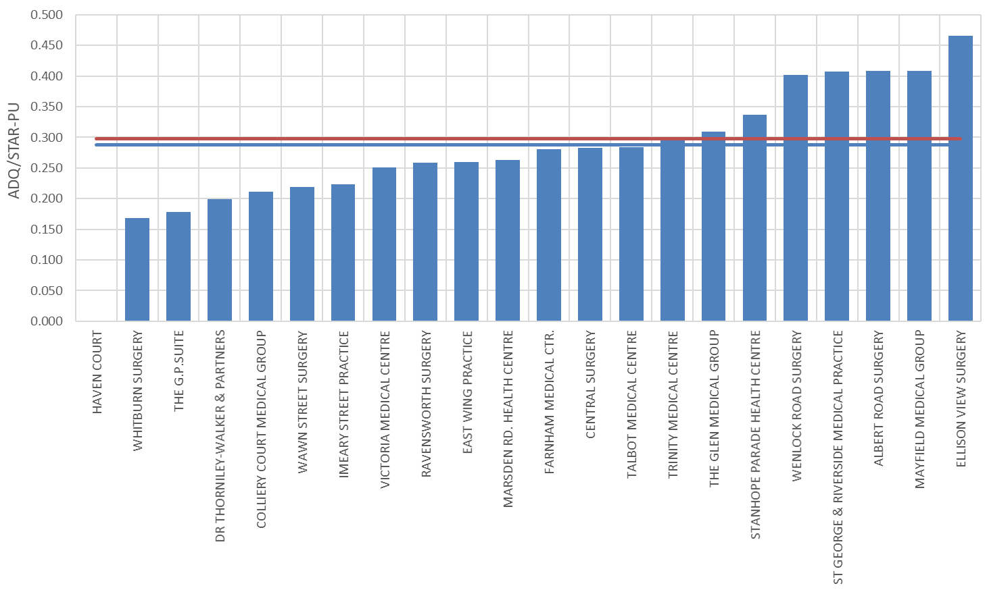
Gabapentinoid Prescribing South Tyneside CCG – Q4 2021

Slide 17
What if Jack asks for more interventional management?
Joint Injection
Orthopaedic opinion
Arthroscopy

Slide 18
Lots of Options for Change
physical stress
fear of movement
joint changes
anxiety
depression
work stress
anger
social isolation
frustration
lack of support
false beliefs
[Lehman 2017]

Slide 19
Reflection
Reflecting on this meeting, how will you apply your learning in practice tomorrow?

Slide 20
Take Home Messages
Pain is influenced by much more than what is going on in the tissues
Take a holistic approach and use personalised care
Work as a team
Changing persistent pain e.g. in OA requires treating the whole person
Exercise is key: hurt does not mean harm
Best evidence-based interventions are rehabilitation and weight loss
Imaging does not correlate with level of pain and function
Medications are of limited benefit
Do not underestimate the power of the placebo (and nocebo) effect

